Slide 1
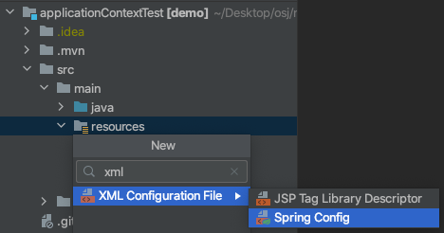

Slide 2
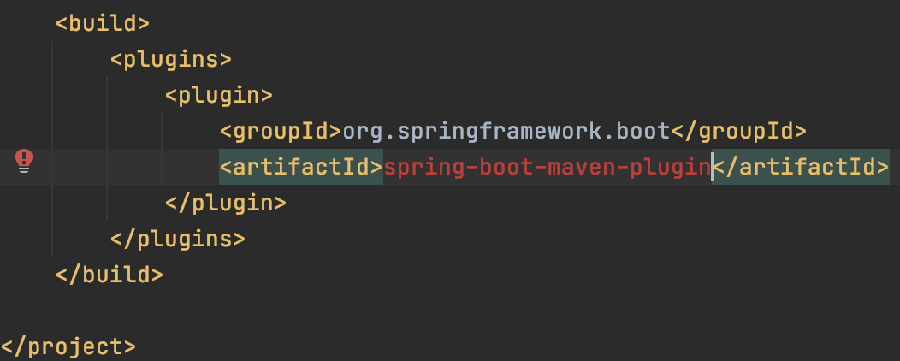
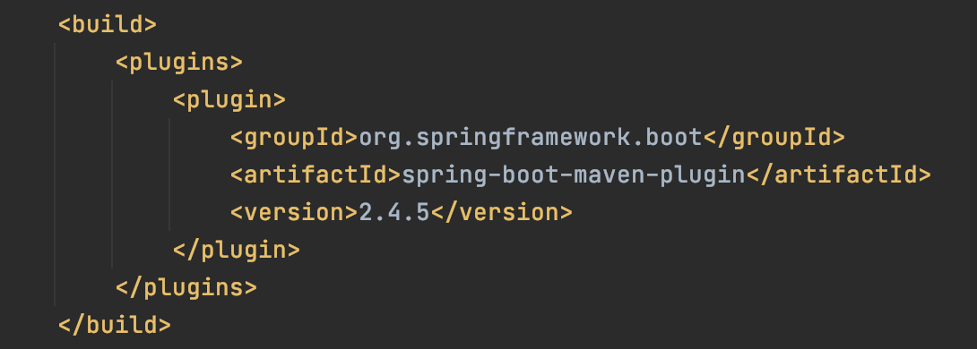
The packaging for this project did not assign a file to the build artifact
버전 추가하면 됨.

Slide 3
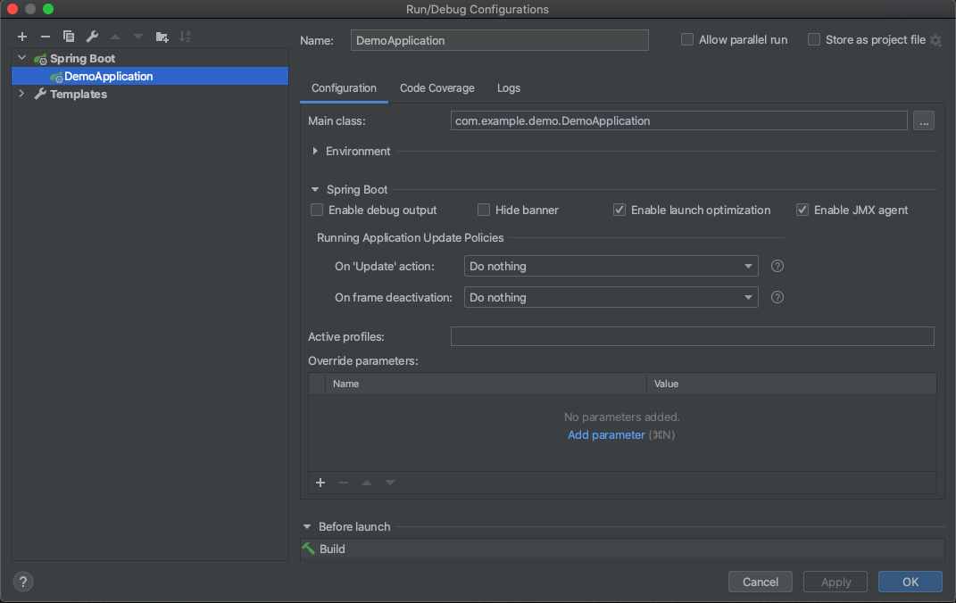


“test”

Slide 4
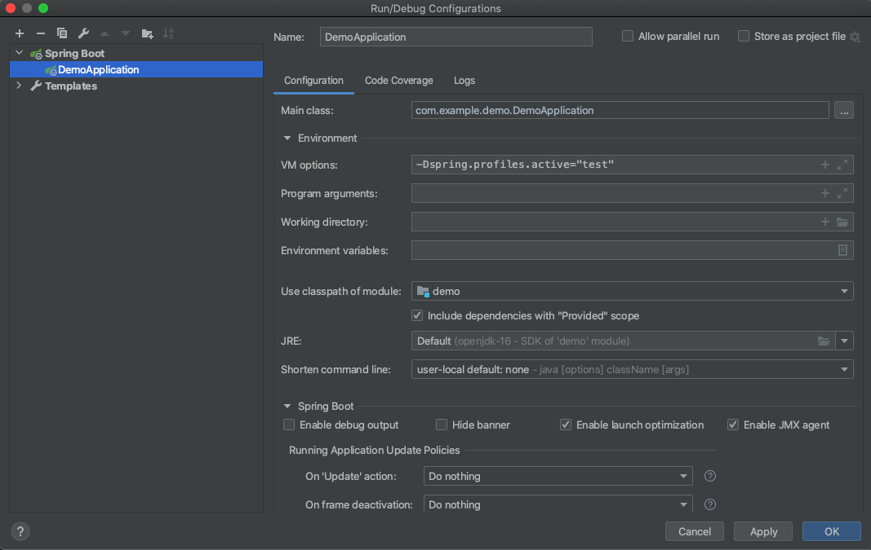

Slide 5
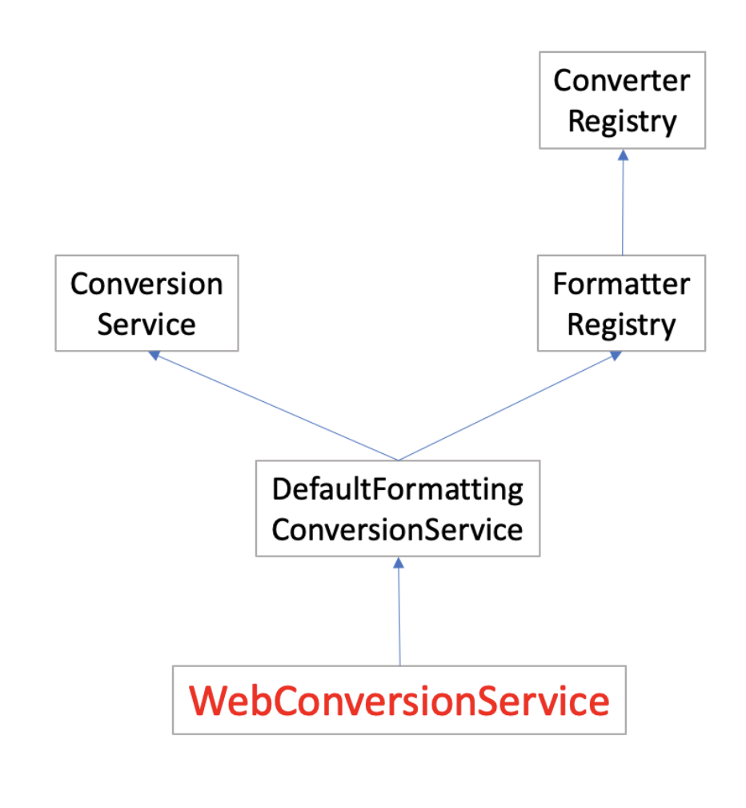

Slide 6
Class A
Class B
Class C
Join point
Target
Aspect A
Aspect B
(시간 측정)
(Transaction)
Aspect
target : A, B
Advice
Pointcut

Slide 7
Client
<Interface>
Subject
Proxy
Real
Subject

Slide 8
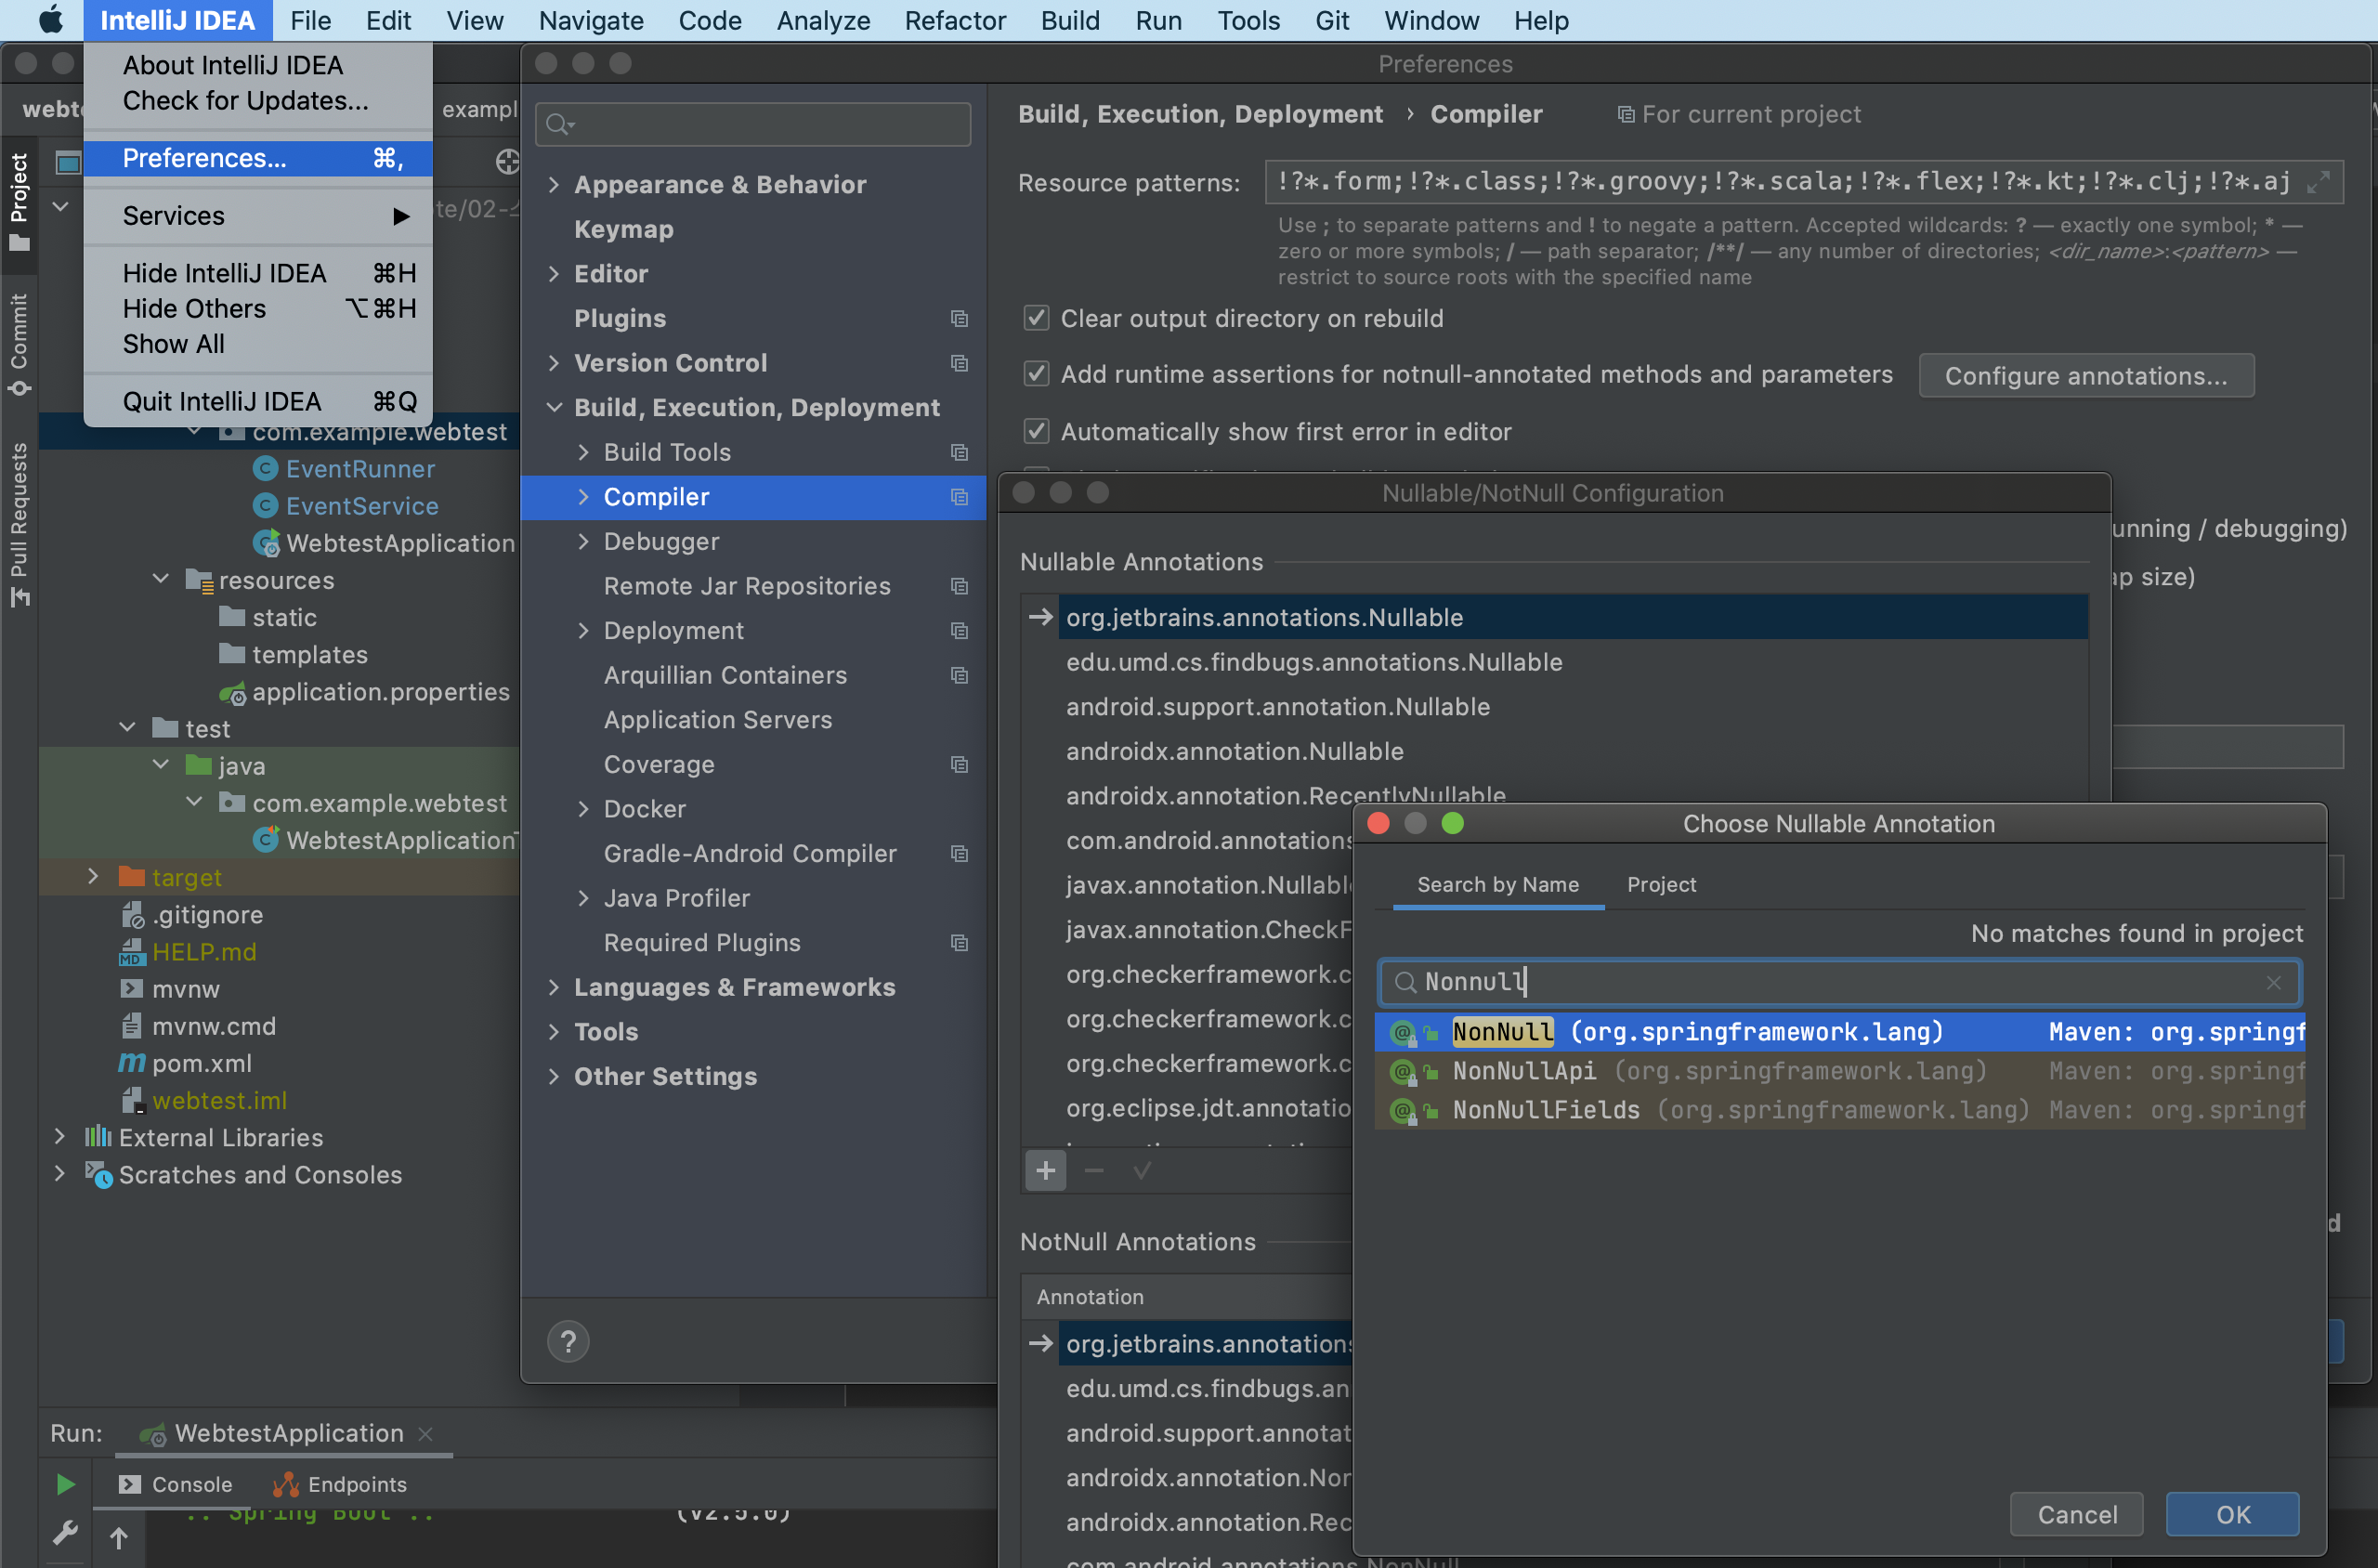

Slide 10
Converter
Registry
Conversion
Service
Formatter
Registry
DefaultFormatting
ConversionService
WebConversionService

